Slide 1
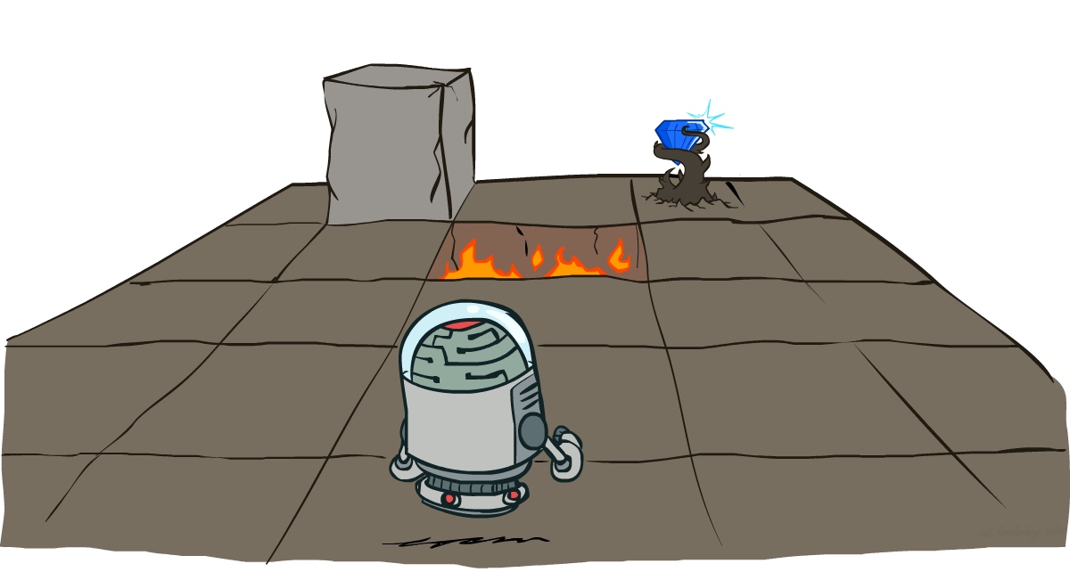
CS 106: Artificial Intelligence
Markov Decision Processes
Instructor: Ngoc-Hoang LUONG, PhD.
University of Information Technology (UIT), VNU-HCM
[These slides were adapted from the slides created by Dan Klein and Pieter Abbeel for CS188 Intro to AI at UC Berkeley. http://ai.berkeley.edu.]
Notes:
Please retain proper attribution, including the reference to ai.berkeley.edu. Thanks!

Slide 2
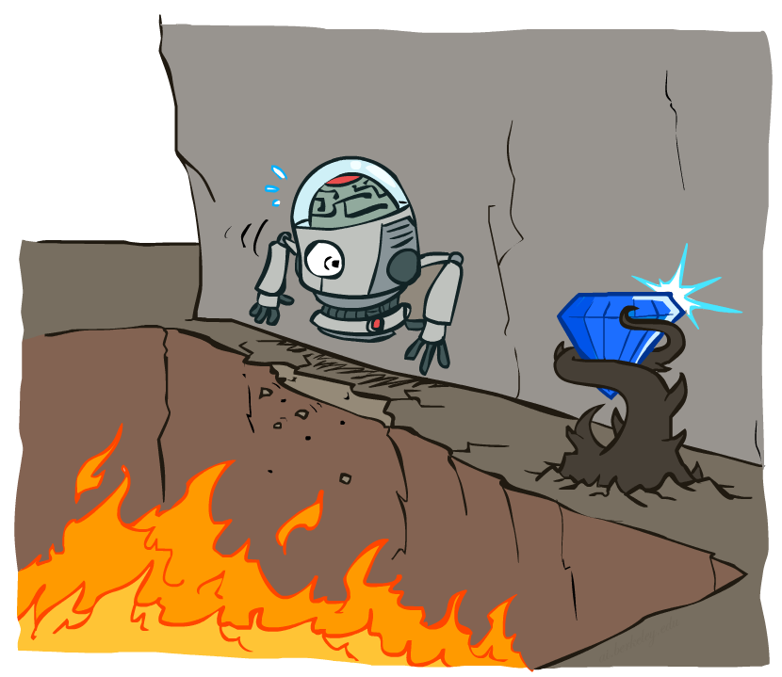
Non-Deterministic Search

Slide 3





Example: Grid World
A maze-like problem
The agent lives in a grid
Walls block the agent’s path
Noisy movement: actions do not always go as planned
80% of the time, the action North takes the agent North (if there is no wall there)
10% of the time, North takes the agent West; 10% East
If there is a wall in the direction the agent would have been taken, the agent stays put
The agent receives rewards each time step
Small “living” reward each step (can be negative)
Big rewards come at the end (good or bad)
Goal: maximize sum of rewards
Notes:
[cut demo of moving around in grid world program]

Slide 4
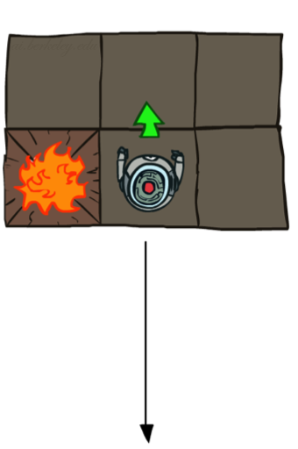
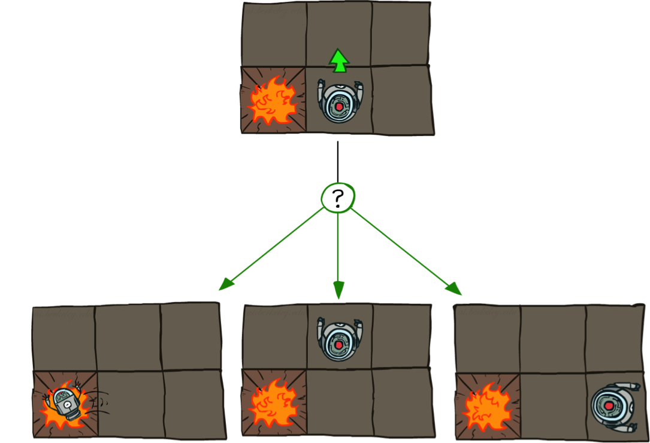

Grid World Actions
Deterministic Grid World
Stochastic Grid World

Slide 5
Markov Decision Processes
An MDP is defined by:
A set of states s ∈ S
A set of actions a ∈ A
A transition function T(s, a, s’)
Probability that a from s leads to s’, i.e., P(s’| s, a)
Also called the model or the dynamics
A reward function R(s, a, s’)
Sometimes just R(s) or R(s’)
A start state
Maybe a terminal state
MDPs are non-deterministic search problems
One way to solve them is with expectimax search
We’ll have a new tool soon
Notes:
In search problems: did not talk about actions, but about successor functions --- now the information inside the successor function is unpacked into actions, transitions and reward
Write out S, A, example entry in T, entry in R
Reward function different from the book : R(s,a,s’)
In book simpler for equations, but not useful for the projects.
Need to modify expectimax a tiny little bit to account for rewards along the way, but that’s something you should be able to do, and so you can already solve MDP’s (not in most efficient way)

Slide 6


What is Markov about MDPs?
“Markov” generally means that given the present state, the future and the past are independent
For Markov decision processes, “Markov” means action outcomes depend only on the current state
Andrey Markov (1856-1922)
Notes:
Like search: successor function only depended on current state
Can make this happen by stuffing more into the state;
Very similar to search problems: when solving a maze with food pellets, we stored which food pellets were eaten

Slide 7

Policies
In deterministic single-agent search problems, we wanted an optimal plan, or sequence of actions, from start to a goal
A policy π: S → A gives an action for each state.
E.g, π((1,1)) = “north”, π((4,1)) = “west”, π((3,3))=“east”, π((3,2))=“north”,…
For MDPs, we want an optimal policy π*: S → A
An optimal policy is one that maximizes expected utility if followed
Expectimax didn’t compute entire policies
It computed the action for a single state only
Optimal policy when R(s, a, s’) = -0.03 for all non-terminals s
Notes:
Dan has a DEMO for this.

Slide 8
Policy
(3,3)
(1,1)
(4,1)

Slide 9

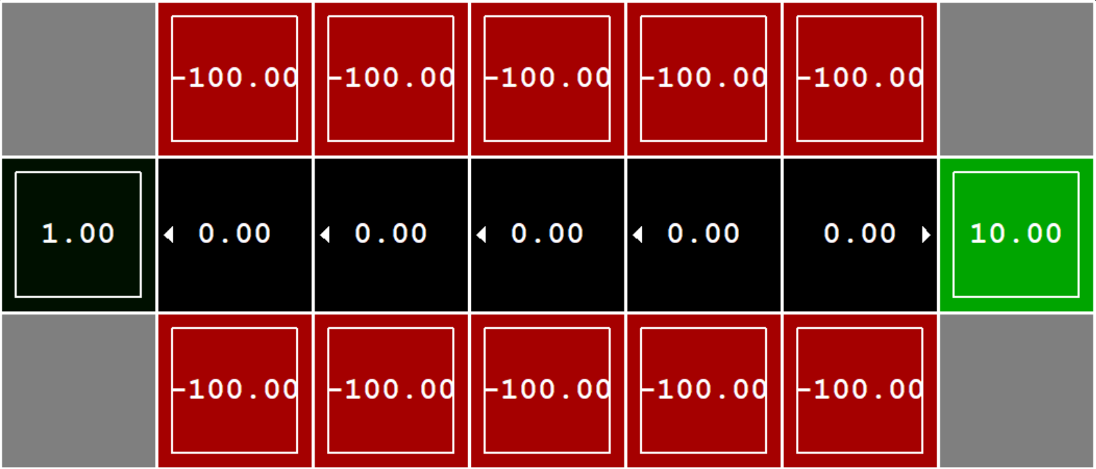

Example: Bridge Crossing

Slide 10


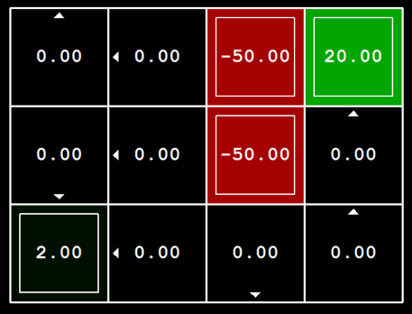

Example: Volcano
123RF.com
shutterstock.com

Slide 11
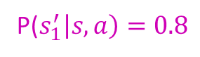
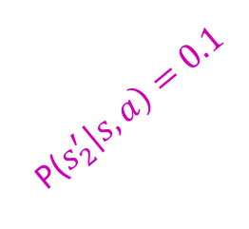
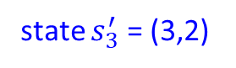
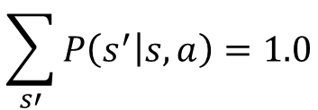
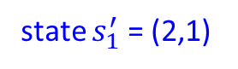
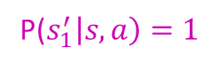
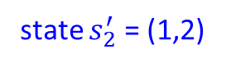
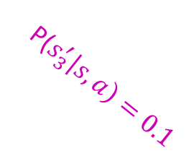
MDP Search Tree
state $s_{2}^{′}$ = (1,2)
state s = (2,2)
P($s_{2}^{′}\left|s,a\right)=0.1$
P($s_{1}^{′}\left|s,a\right)=1$
action a = “south”
P($s_{1}^{′}\left|s,a\right)=0.8$
state $s_{1}^{′}$ = (2,1)
P($s_{3}^{′}\left|s,a\right)=0.1$
$$\sum_{s′}{P\left(s^{′} | s,a\right)=1.0}$$
state $s_{3}^{′}$ = (3,2)

Slide 12
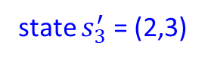
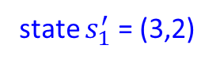

MDP Search Tree
state $s_{2}^{′}$ = (2,1)
state s = (2,2)
P($s_{2}^{′}\left|s,a\right)=0.1$
action a = “east”
P($s_{1}^{′}\left|s,a\right)=0.8$
state $s_{1}^{′}$ = (3,2)
P($s_{3}^{′}\left|s,a\right)=0.1$
$$\sum_{s′}{P\left(s^{′} | s,a\right)=1.0}$$
state $s_{3}^{′}$ = (2,3)

Slide 13
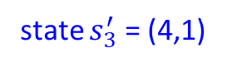
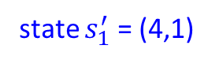
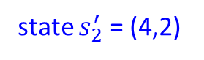
MDP Search Tree
state $s_{2}^{′}$ = (4,2)
state s = (4,1)
P($s_{2}^{′}\left|s,a\right)=0.1$
action a = “east”
P($s_{1}^{′}\left|s,a\right)=0.8$
state $s_{1}^{′}$ = (4,1)
P($s_{3}^{′}\left|s,a\right)=0.1$
$$\sum_{s′}{P\left(s^{′} | s,a\right)=1.0}$$
state $s_{3}^{′}$ = (4,1)

Slide 14


MDP Search Trees
Each MDP state projects an expectimax-like search tree
s
s is a state
a
(s, a) is a q-state
s, a
(s,a,s’) called a transition
T(s,a,s’) = P(s’|s,a)
R(s,a,s’)
s,a,s’
s’
Notes:
In MDP chance node represents uncertainty about what might happen based on (s,a) [as opposed to being a random adversary]
Q-state (s,a) is when you were in a state and took an action

Slide 15
Optimal Policies
R(s) = -0.01
R(s) = -0.03
R(s) = -0.4
R(s) = -2.0
R(s) = the “living reward”
Notes:
R(s) = the “living reward”

Slide 16

Policy Evaluation

Slide 17
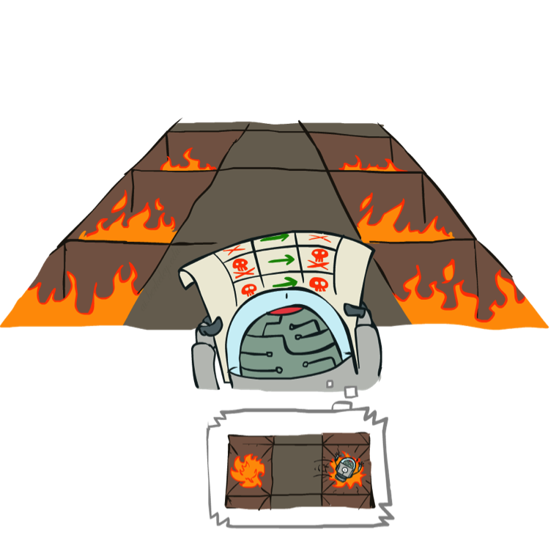
Example: Policy Evaluation
Always Go Right
Always Go Forward

Slide 18
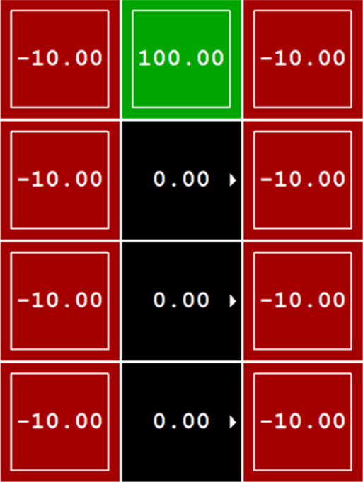
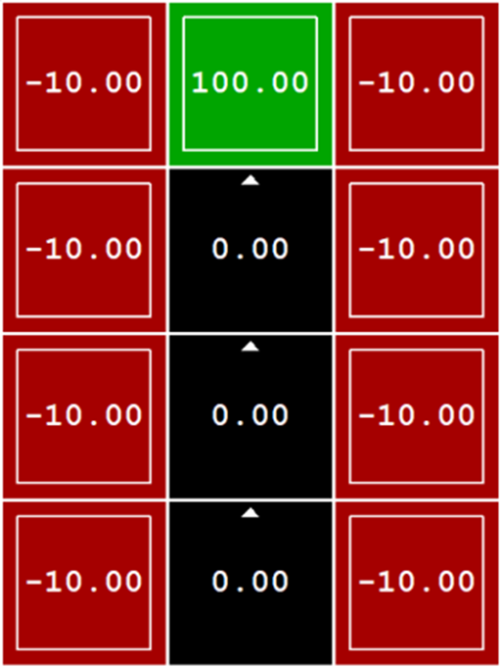
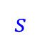
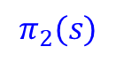
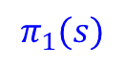
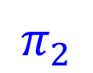
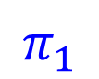
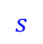
Example: Policy Evaluation
$$π_{1}$$
$$π_{2}$$
$$s$$
$$π_{1}(s)$$
$$s$$
$$π_{2}(s)$$
State | Action
(2,1) | “east”
(2,2) | “east”
(2,3) | “east”
(2,4) | “exit”
(1,3) | “exit”
… | …
State | Action
(2,1) | “north”
(2,2) | “north”
(2,3) | “north”
(2,4) | “exit”
(1,3) | “exit”
… | …

Slide 19
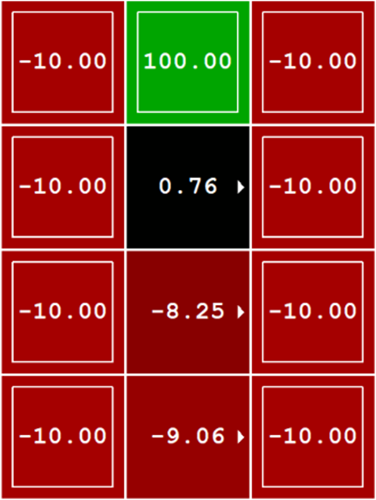
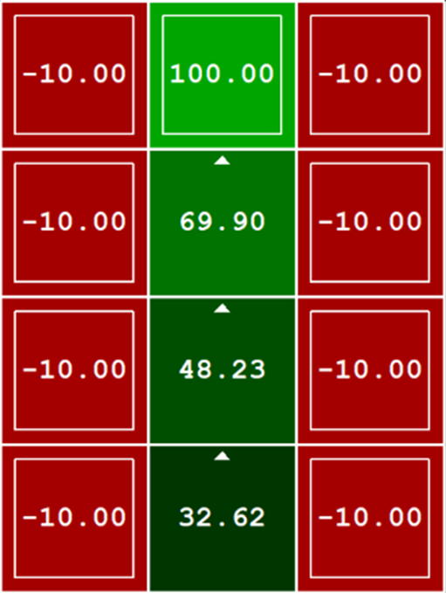


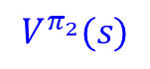
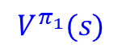
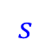
Example: Policy Evaluation
$$π_{1}$$
$$π_{2}$$
$$s$$
$$π_{1}(s)$$
$$V^{π_{1}}(s)$$
$$s$$
$$π_{2}(s)$$
$$V^{π_{2}}(s)$$
State | Action | Value
(2,1) | “east” | -9.06
(2,2) | “east” | -8.25
(2,3) | “east” | 0.76
(2,4) | “exit” | 100
(1,3) | “exit” | -10
… | … | …
State | Action | Value
(2,1) | “north” | 32.62
(2,2) | “north” | 48.23
(2,3) | “north” | 69.60
(2,4) | “exit” | 100
(1,3) | “exit” | -10
… | … | …
$$≤$$

Slide 20
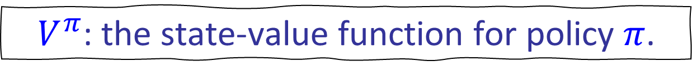
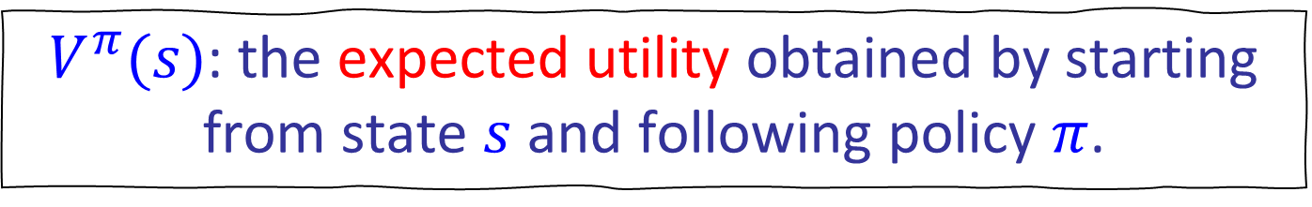
Policy Evaluation
$V^{π}(s)$: the expected utility obtained by starting from state $s$ and following policy $π$.
$V^{π}$: the state-value function for policy $π$.
$π_{2}≥π_{1}$ if and only if $V^{π_{2}}(s)≥V^{π_{1}}(s)$, for all $s∈S$.

Slide 21

Utility of a sequence of actions
Exit
Living Reward = 0, Noise = 0
$$U=0+0+\left(0+0.5\right)+0+0+0+20=20.5$$
$$U=\left(0+0.5\right)+0+0+0+\left(0+0.5\right)+0+0+0+20=21$$

Slide 22

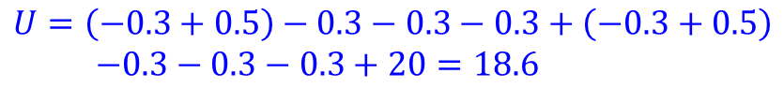
Utility of a sequence of actions
Exit
Living Reward = -0.3, Noise = 0.0
$$U=−0.3−0.3+\left(−0.3+0.5\right)−0.3−0.3−0.3+20=18.7$$
$$U=\left(−0.3+0.5\right)−0.3−0.3−0.3+\left(−0.3+0.5\right)$$ $−0.3−0.3−0.3+20=18.6$
Utility $\sim$ Sum of Rewards

Slide 23

Utility of a sequence of actions
Exit
Living Reward = -0.3, Noise = 0.2
Exit
$$U=−0.3−0.3+\left(−0.3+0.5\right)−0.3−0.3−0.3+20=18.7$$
$$U=−0.3−0.3+\left(−0.3+0.5\right)−0.3−50=−50.7$$
$$U=−0.3−0.3−50=−50.6$$
Expected Utility $\sim$ Average Sum of Rewards
Utility $\sim$ Sum of Rewards

Slide 24
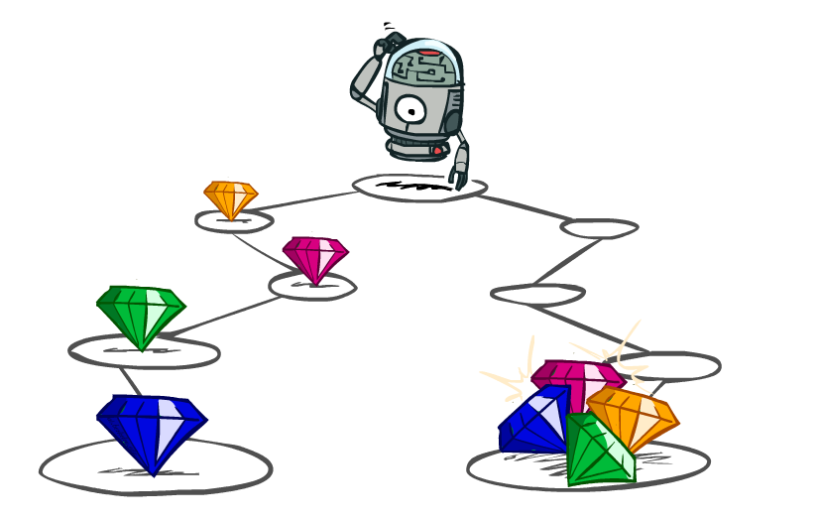
Utilities of Sequences

Slide 25
Utilities of Sequences
What preferences should an agent have over reward sequences?
More or less?
Now or later?
[1, 2, 2]
or
[2, 3, 4]
[0, 0, 1]
or
[1, 0, 0]

Slide 26




Discounting
It’s reasonable to maximize the sum of rewards
It’s also reasonable to prefer rewards now to rewards later
One solution: values of rewards decay exponentially
Worth Now
Worth Next Step
Worth In Two Steps

Slide 27

Discounting
How to discount?
Each time we descend a level, we multiply in the discount once
Why discount?
Sooner rewards probably do have higher utility than later rewards
Also helps our algorithms converge
Example: discount of 0.5
U([1,2,3]) = 1*1 + 0.5*2 + 0.25*3
U([1,2,3]) < U([3,2,1])
Notes:
Rewards in the future (deeper in the tree) matter less
Interesting: running expectimax, if having to truncate the search, then not losing much; e.g., less then \gamma^d / (1-\gamma)

Slide 28
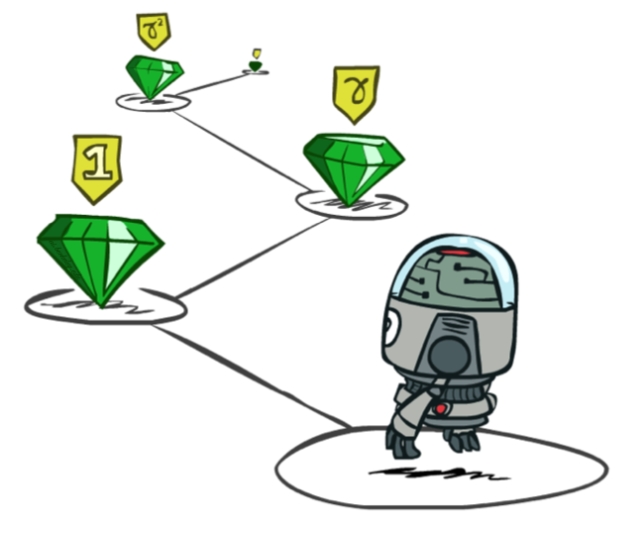
Stationary Preferences
There are two ways to define utilities
Additive utility:
Discounted utility:

Slide 29

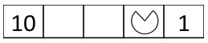
Quiz: Discounting
Given:
Actions: East, West, and Exit (only available in exit states a, e)
Transitions: deterministic
Quiz 1: For γ = 1, what is the optimal policy?
Quiz 2: For γ = 0.1, what is the optimal policy?
Quiz 3: For which γ are West and East equally good when in state d?

Slide 30

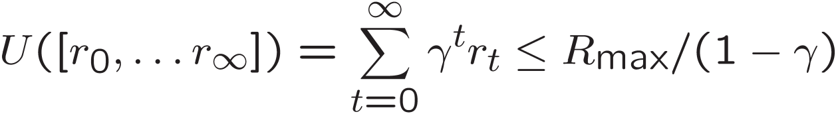
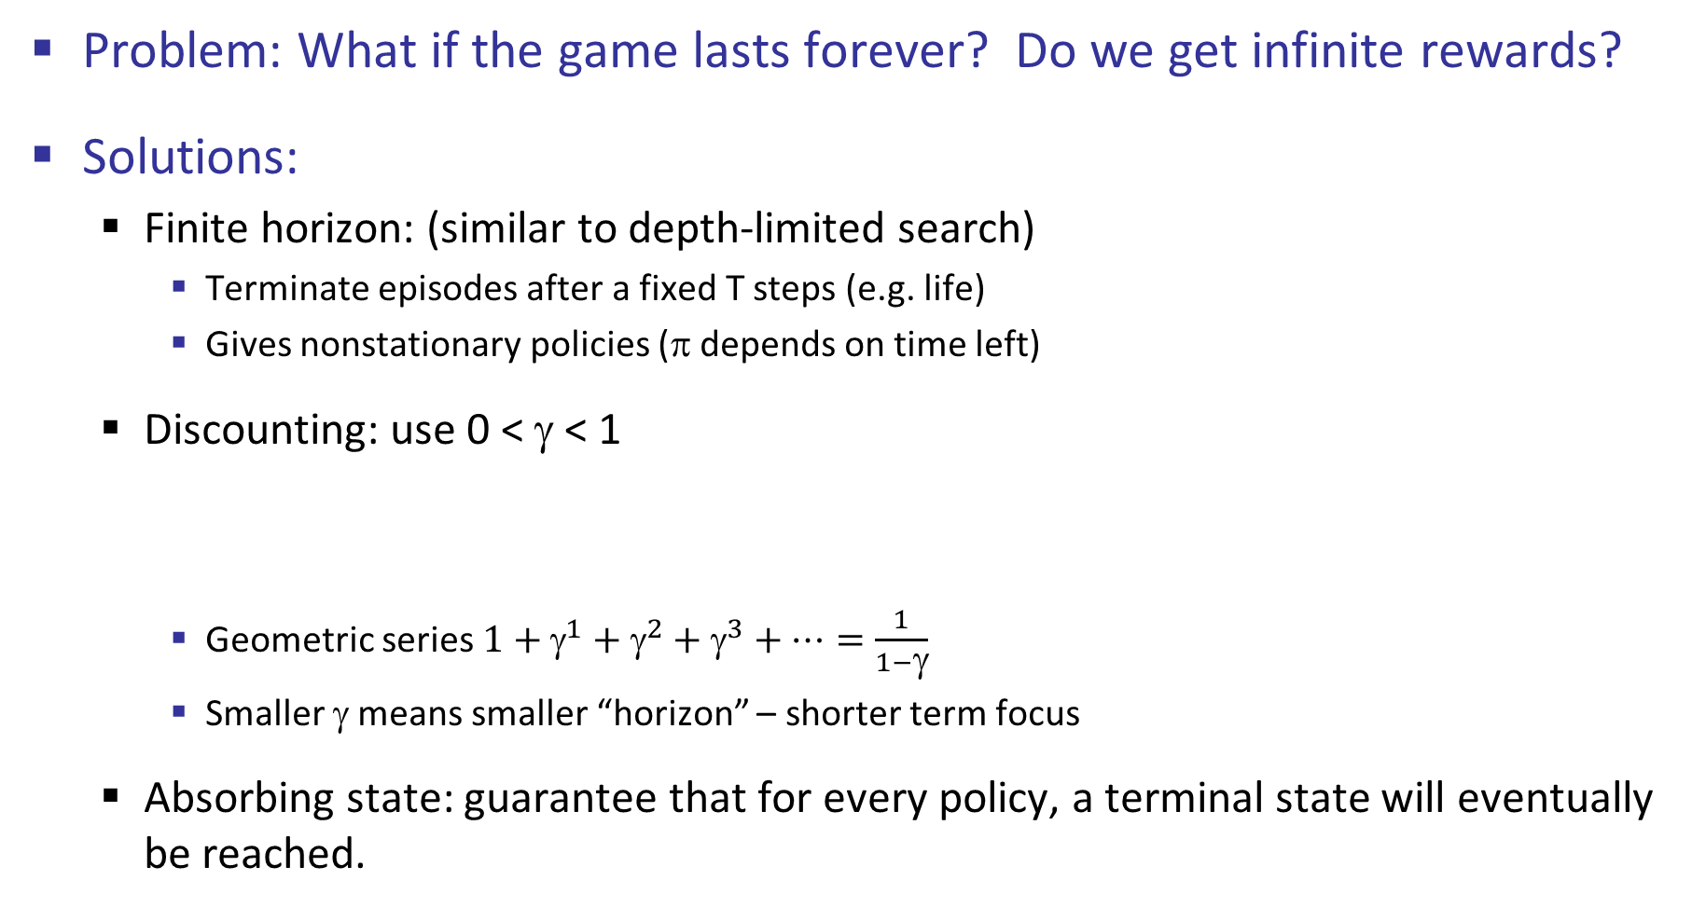
Infinite Utilities?!
Problem: What if the game lasts forever? Do we get infinite rewards?
Solutions:
Finite horizon: (similar to depth-limited search)
Terminate episodes after a fixed T steps (e.g. life)
Gives nonstationary policies (π depends on time left)
Discounting: use 0 < γ < 1
Geometric series $1+{\text{γ}}^{1}+{\text{γ}}^{2}+{\text{γ}}^{3}+…=\frac{1}{1−\text{γ}}$
Smaller γ means smaller “horizon” – shorter term focus
Absorbing state: guarantee that for every policy, a terminal state will eventually be reached.

Slide 31

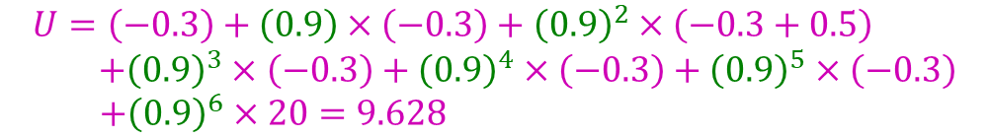
Utility of a sequence of actions
Exit
Living Reward = -0.3, Noise = 0.0
$$U=\left(−0.3\right)+\left(0.9\right)×\left(−0.3\right)+{\left(0.9\right)}^{2}×\left(−0.3+0.5\right) \\ +{\left(0.9\right)}^{3}×\left(−0.3\right)+{\left(0.9\right)}^{4}×\left(−0.3\right)+{\left(0.9\right)}^{5}×\left(−0.3\right)$$ $+{\left(0.9\right)}^{6}×20=9.628$
$$U=\left(−0.3\right)+\left(0.9\right)×2=1.5$$
Exit
Utility $\sim$ Sum of Discounted Rewards
Utility $\sim$ Sum of Rewards

Slide 32
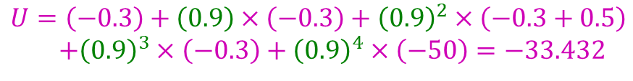

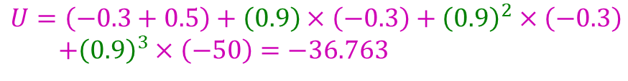
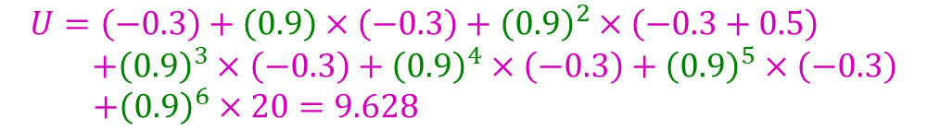
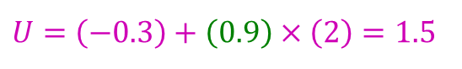
Utility of a sequence of actions
Living Reward = -0.3, Noise = 0.2
Exit
Exit
$$U=\left(−0.3\right)+\left(0.9\right)×\left(−0.3\right)+{\left(0.9\right)}^{2}×\left(−0.3+0.5\right) \\ +{\left(0.9\right)}^{3}×\left(−0.3\right)+{\left(0.9\right)}^{4}×\left(−0.3\right)+{\left(0.9\right)}^{5}×\left(−0.3\right)$$ $+{\left(0.9\right)}^{6}×20=9.628$
$$U=\left(−0.3\right)+\left(0.9\right)×\left(−0.3\right)+{\left(0.9\right)}^{2}×\left(−0.3+0.5\right) \\ +{\left(0.9\right)}^{3}×\left(−0.3\right)+{\left(0.9\right)}^{4}×\left(−50\right)=−33.432$$
Exit
$$U=\left(−0.3\right)+\left(0.9\right)×\left(−0.3\right)+{\left(0.9\right)}^{2}×\left(−50\right)=−41.07$$
$$U=\left(−0.3\right)+\left(0.9\right)×\left(2\right)=1.5$$
Exit
$$U=\left(−0.3+0.5\right)+\left(0.9\right)×\left(−0.3\right)+{\left(0.9\right)}^{2}×\left(−0.3\right) \\ +{\left(0.9\right)}^{3}×\left(−50\right)=−36.763$$
Expected Utility $\sim$ Average Sum of Discounted Rewards
Utility $\sim$ Sum of Discounted Rewards

Slide 33
Solving MDPs

Slide 34

Policy Evaluation

Slide 35

Policy Evaluation
Regarding the current state, how good is it according to a policy π?
state s = (2,2)

Slide 36

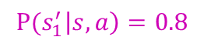
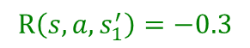
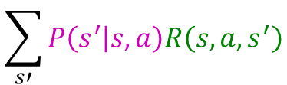
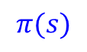


















Policy Evaluation
$$\sum_{s′}{P\left(s^{′} | s,a\right)=1.0}$$
$$V^{π}\left(s\right)$$
expected utility of state s=(2,2) by following 𝜋
state $s_{2}^{′}$ = (1,2)
expected utility of state (1,2) by following 𝜋
expected utility of state (1,2)
$$=\sum_{s′}{P\left(s^{′} | s,\text{π}(s)\right)[R\left(s,\text{π}(s),s^{′}\right)+γV^{π}\left(s′\right)]}$$
$$V^{π}\left(s\right)$$
$$V^{π}\left(s\right)= Q^{π}\left(s,π(s)\right)$$
$V^{π}(s_{2}^{′}$)
$$P(s_{2}^{′}\left|s,a\right)=0.1$$
state s = (2,2)
$$R\left(s,a,s_{2}^{′}\right)=−0.3+0.5$$
state $s_{1}^{′}$ = (2,1)
expected utility of state (2,1)
by following 𝜋
action a = “south”
expected utility of state (2,1)
$$P(s_{1}^{′}\left|s,a\right)=0.8$$
$$R\left(s,a,s_{1}^{′}\right)=−0.3$$
$V^{π}(s_{1}^{′}$)
$$Q^{π}\left(s,a\right)$$
$$π(s)$$
$${R(s,a,s}_{3}^{′})=−0.3$$
$${P(s}_{3}^{′}\left|s,a\right)=0.1$$
state $s_{3}^{′}$ = (3,2)
State | Action
(2,2) | “south”
(1,2) | “east”
(2,1) | “east”
(3,2) | “exit”
… | …
Expected Utility of taking action a=“south” in state s = (2,2) and then following 𝜋
Expected Utility of taking action a=“south” in state s = (2,2)
= ?
expected utility of state (3,2)
Exit
expected utility of state (3,2)
by following 𝜋
?
$$Q^{π}\left(s,a\right)=\sum_{s′}{P\left(s^{′} | s,a\right)[R\left(s,a,s^{′}\right)+γV^{π}\left(s′\right)]}$$
$$\sum_{s′}{P\left(s^{′} | s,a\right)[R\left(s,a,s^{′}\right)+γV^{π}\left(s′\right)]}$$
$$\sum_{s′}{P\left(s^{′} | s,a\right)R\left(s,a,s^{′}\right)}$$
$V^{π}(s_{3}^{′}$)

Slide 37







Policy Evaluation
$V^{π}(s)$
s
$V^{π}(s)$: the expected utility obtained by starting from state $s$ and following policy $π$.
π(s)
s, π(s)
s, π(s),s’
$V^{π}$: the state-value function for policy $π$.
s’
$V^{π}(s′)$
s
$Q^{π}(s,a)$: the expected utility obtained by starting from state $s$, taking action $a$, and then following policy $π$.
a
s, a
$Q^{π}(s,a)$
s,a,s’
$Q^{π}$: the action-value function for policy $π$.
s’
$V_{π}(s′)$

Slide 38








Policy Evaluation
$$V^{π}(s\text{)}=\sum_{s′}{P\left(s^{′} | s,\text{π}(s)\right)[R\left(s,\text{π}(s),s^{′}\right)+γV^{π}\left(s′\right)]}$$
$V^{π}([2,\text{4])}=$ $1.0\left(100+0.9(0.0)\right)=100$
$V^{π}([1,\text{3])}=$ $1.0\left(−10+0.9(0.0)\right)=−10$
$V^{π}([3,\text{2])}=$ $1.0\left(−10+0.9(0.0)\right)=−10$
$$…………………………….$$
State $s$ | Action $π_{1}(s)$
[2,1] | “east”
[2,2] | “east”
[2,3] | “east”
[2,4] | “exit”
[1,3] | “exit”
… | …
$V^{π}([2,1\text{])}=$ $0.8\left(−0.3+0.9V^{π}\left(\left[3,1\right]\right)\right)+0.1\left(−0.3+0.9V^{π}\left(\left[2,2\right]\right)\right)+0.1\left(−0.3+0.9V^{π}\left(\left[2,1\right]\right)\right)$
$V^{π}([2,\text{2])}=$ $0.8\left(−0.3+0.9V^{π}\left(\left[3,2\right]\right)\right)+0.1\left(−0.3+0.9V^{π}\left(\left[2,3\right]\right)\right)+0.1\left(−0.3+0.9V^{π}\left(\left[2,1\right]\right)\right)$
$V^{π}([2,\text{3])}=$ $0.8\left(−0.3+0.9V^{π}\left(\left[3,3\right]\right)\right)+0.1\left(−0.3+0.9V^{π}\left(\left[2,4\right]\right)\right)+0.1\left(−0.3+0.9V^{π}\left(\left[2,2\right]\right)\right)$
Solving a system of linear equations

Slide 39


















(Iterative) Policy Evaluation
$$V^{π}(s\text{)}=Q^{π}\left(s,π(s)\right)=\sum_{s′}{P\left(s^{′} | s,\text{π}(s)\right)[R\left(s,\text{π}(s),s^{′}\right)+γV^{π}\left(s′\right)]}$$
Iterative Approach
$V^{π}(s_{2}^{′}$)
Initialize $V_{0}^{π}\left(s\right)⟵0$ for all states $s$.
Repeat until convergence: $t=1, 2, 3,…$
// While $\max_{s}{({|V}_{t}^{π}(s\text{)}−V_{t−1}^{π}(s\text{)}\text{|})>ε≈0.00001}$
For each state $s$:
$V^{π}(s$)
$$P(s_{2}^{′}\left|s,a\right)$$
$$Q^{π}\left(s,a\right)$$
$$R\left(s,a,s_{2}^{′}\right)$$
a = $\text{π}(s)$
$$P(s_{1}^{′}\left|s,a\right)$$
$$V_{t}^{π}(s\text{)}⟵\sum_{s′}{P(s^{′}|s,\text{π}\left(s\right))[R\left(s,\text{π}(s),s^{′}\right)+γV_{t−1}^{π}\left(s′\right)]}$$
$$R\left(s,a,s_{1}^{′}\right)$$
$V^{π}(s_{1}^{′}$)
$${R(s,a,s}_{3}^{′})$$
$${P(s}_{3}^{′}\left|s,a\right)$$
$$Q_{t−1}^{π}(s,π(s))$$
$V^{π}(s_{3}^{′}$)

Slide 40
Example: Policy Evaluation
Always Go Right
Always Go Forward

Slide 41







Example: Policy Evaluation
Noise = 0.2
Discount = 0.9
Living reward = -0.3
$$π_{1}$$
$$π_{2}$$
$$π_{1}(s)$$
$$π_{2}(s)$$
State $s$ | Action $π_{1}(s)$
(2,1) | “east”
(2,2) | “east”
(2,3) | “east”
(2,4) | “exit”
(1,3) | “exit”
… | …
State $s$ | Action $π_{2}(s)$
(2,1) | “north”
(2,2) | “north”
(2,3) | “north”
(2,4) | “exit”
(1,3) | “exit”
… | …

Slide 42


t=0
Noise = 0.2
Discount = 0.9
Living reward = -0.3
$V_{0}^{π}\left(s\right)⟵0$

Slide 43








t=0 → t=1
Noise = 0.2
Discount = 0.9
Living reward = -0.3
$$V_{t}^{π}(s\text{)}⟵\sum_{s′}{P(s^{′}|s,\text{π}\left(s\right))[R\left(s,\text{π}(s),s^{′}\right)+γV_{t−1}^{π}\left(s′\right)]}$$
$$Q_{t−1}^{π}(s,π(s))$$
$$V_{t−1}^{π}\left(s\right)$$
$$V_{t}^{π}\left(s\right)$$
$$V_{1}^{π}\left(2,4\right)=100$$
$$V_{1}^{π}\left(1,1\right)=−10$$
$$V_{1}^{π}\left(2,2\right)=\left(0.8\right)×\left(−0.3+0.9V_{0}^{π}\left(3,2\right)\right) \\ +\left(0.1\right)×\left(−0.3+0.9V_{0}^{π}\left(2,3\right)\right) \\ +\left(0.1\right)×\left(−0.3+0.9V_{0}^{π}\left(2,1\right)\right)=−0.3$$

Slide 44




t=1 → t=2
Noise = 0.2
Discount = 0.9
Living reward = -0.3
$$V_{t}^{π}(s\text{)}⟵\sum_{s′}{P(s^{′}|s,\text{π}\left(s\right))[R\left(s,\text{π}(s),s^{′}\right)+γV_{t−1}^{π}\left(s′\right)]}$$
$$Q_{t−1}^{π}(s,π(s))$$
$$V_{t−1}^{π}\left(s\right)$$
$$V_{t}^{π}\left(s\right)$$
$$V_{2}^{π}\left(2,2\right)=\left(0.8\right)×\left(−0.3+0.9V_{1}^{π}\left(3,2\right)\right) \\ +\left(0.1\right)×\left(−0.3+0.9V_{1}^{π}\left(2,3\right)\right) \\ +\left(0.1\right)×\left(−0.3+0.9V_{1}^{π}\left(2,1\right)\right) \\ =\left(0.8\right)×\left(−0.3+0.9(−10)\right) \\ +\left(0.1\right)×\left(−0.3+0.9(−0.3)\right) \\ +\left(0.1\right)×\left(−0.3+0.9(−0.3)\right)≈−7.55$$
$$V_{2}^{π}\left(2,3\right)=\left(0.8\right)×\left(−0.3+0.9V_{1}^{π}\left(3,3\right)\right) \\ +\left(0.1\right)×\left(−0.3+0.9V_{1}^{π}\left(2,4\right)\right) \\ +\left(0.1\right)×\left(−0.3+0.9V_{1}^{π}\left(2,2\right)\right) \\ =\left(0.8\right)×\left(−0.3+0.9(−10)\right) \\ +\left(0.1\right)×\left(−0.3+0.9(100)\right) \\ +\left(0.1\right)×\left(−0.3+0.9(−0.3)\right)≈1.47$$

Slide 45




t=2 → t=3
Noise = 0.2
Discount = 0.9
Living reward = -0.3
$$V_{t}^{π}(s\text{)}⟵\sum_{s′}{P(s^{′}|s,\text{π}\left(s\right))[R\left(s,\text{π}(s),s^{′}\right)+γV_{t−1}^{π}\left(s′\right)]}$$
$$Q_{t−1}^{π}(s,π(s))$$
$$V_{t−1}^{π}\left(s\right)$$
$$V_{t}^{π}\left(s\right)$$
$$V_{3}^{π}\left(2,2\right)=\left(0.8\right)×\left(−0.3+0.9V_{2}^{π}\left(3,2\right)\right) \\ +\left(0.1\right)×\left(−0.3+0.9V_{2}^{π}\left(2,3\right)\right) \\ +\left(0.1\right)×\left(−0.3+0.9V_{2}^{π}\left(2,1\right)\right) \\ =\left(0.8\right)×\left(−0.3+0.9(−10)\right) \\ +\left(0.1\right)×\left(−0.3+0.9(1.47)\right) \\ +\left(0.1\right)×\left(−0.3+0.9(−7.55)\right)≈−8.05$$
$$V_{3}^{π}\left(2,1\right)=\left(0.8\right)×\left(−0.3+0.9V_{2}^{π}\left(3,1\right)\right) \\ +\left(0.1\right)×\left(−0.3+0.9V_{2}^{π}\left(2,2\right)\right) \\ +\left(0.1\right)×\left(−0.3+0.9V_{2}^{π}\left(2,1\right)\right) \\ =\left(0.8\right)×\left(−0.3+0.9(−10)\right) \\ +\left(0.1\right)×\left(−0.3+0.9(−7.55)\right) \\ +\left(0.1\right)×\left(−0.3+0.9(−7.55)\right)≈−8.86$$

Slide 46




t=3 → t=4
Noise = 0.2
Discount = 0.9
Living reward = -0.3
$$V_{t}^{π}(s\text{)}⟵\sum_{s′}{P(s^{′}|s,\text{π}\left(s\right))[R\left(s,\text{π}(s),s^{′}\right)+γV_{t−1}^{π}\left(s′\right)]}$$
$$Q_{t−1}^{π}(s,π(s))$$
$$V_{t−1}^{π}\left(s\right)$$
$$V_{t}^{π}\left(s\right)$$
$$V_{4}^{π}\left(2,2\right)=\left(0.8\right)×\left(−0.3+0.9V_{3}^{π}\left(3,2\right)\right) \\ +\left(0.1\right)×\left(−0.3+0.9V_{3}^{π}\left(2,3\right)\right) \\ +\left(0.1\right)×\left(−0.3+0.9V_{3}^{π}\left(2,1\right)\right) \\ =\left(0.8\right)×\left(−0.3+0.9(−10)\right) \\ +\left(0.1\right)×\left(−0.3+0.9(0.82)\right) \\ +\left(0.1\right)×\left(−0.3+0.9(−8.86)\right)≈−8.22$$
$$V_{4}^{π}\left(2,1\right)=\left(0.8\right)×\left(−0.3+0.9V_{3}^{π}\left(3,1\right)\right) \\ +\left(0.1\right)×\left(−0.3+0.9V_{3}^{π}\left(2,2\right)\right) \\ +\left(0.1\right)×\left(−0.3+0.9V_{3}^{π}\left(2,1\right)\right) \\ =\left(0.8\right)×\left(−0.3+0.9(−10)\right) \\ +\left(0.1\right)×\left(−0.3+0.9(−8.05)\right) \\ +\left(0.1\right)×\left(−0.3+0.9(−8.86)\right)≈−9.02$$

Slide 47




t=4 → t=5
Noise = 0.2
Discount = 0.9
Living reward = -0.3
$$V_{t}^{π}(s\text{)}⟵\sum_{s′}{P(s^{′}|s,\text{π}\left(s\right))[R\left(s,\text{π}(s),s^{′}\right)+γV_{t−1}^{π}\left(s′\right)]}$$
$$Q_{t−1}^{π}(s,π(s))$$
$$V_{t−1}^{π}\left(s\right)$$
$$V_{t}^{π}\left(s\right)$$
$$V_{5}^{π}\left(2,2\right)=\left(0.8\right)×\left(−0.3+0.9V_{4}^{π}\left(3,2\right)\right) \\ +\left(0.1\right)×\left(−0.3+0.9V_{4}^{π}\left(2,3\right)\right) \\ +\left(0.1\right)×\left(−0.3+0.9V_{4}^{π}\left(2,1\right)\right) \\ =\left(0.8\right)×\left(−0.3+0.9(−10)\right) \\ +\left(0.1\right)×\left(−0.3+0.9(0.78)\right) \\ +\left(0.1\right)×\left(−0.3+0.9(−9.02)\right)≈−8.24$$
$$V_{5}^{π}\left(2,3\right)=\left(0.8\right)×\left(−0.3+0.9V_{4}^{π}\left(3,3\right)\right) \\ +\left(0.1\right)×\left(−0.3+0.9V_{4}^{π}\left(2,4\right)\right) \\ +\left(0.1\right)×\left(−0.3+0.9V_{4}^{π}\left(2,2\right)\right) \\ =\left(0.8\right)×\left(−0.3+0.9(−10)\right) \\ +\left(0.1\right)×\left(−0.3+0.9(100)\right) \\ +\left(0.1\right)×\left(−0.3+0.9(−8.22)\right)≈0.76$$

Slide 48




t=5 → t=6
Noise = 0.2
Discount = 0.9
Living reward = -0.3
$$V_{t}^{π}(s\text{)}⟵\sum_{s′}{P(s^{′}|s,\text{π}\left(s\right))[R\left(s,\text{π}(s),s^{′}\right)+γV_{t−1}^{π}\left(s′\right)]}$$
$$Q_{t−1}^{π}(s,π(s))$$
$$V_{t−1}^{π}\left(s\right)$$
$$V_{t}^{π}\left(s\right)$$
$$V_{6}^{π}\left(2,2\right)=\left(0.8\right)×\left(−0.3+0.9V_{5}^{π}\left(3,2\right)\right) \\ +\left(0.1\right)×\left(−0.3+0.9V_{5}^{π}\left(2,3\right)\right) \\ +\left(0.1\right)×\left(−0.3+0.9V_{5}^{π}\left(2,1\right)\right) \\ =\left(0.8\right)×\left(−0.3+0.9(−10)\right) \\ +\left(0.1\right)×\left(−0.3+0.9(0.76)\right) \\ +\left(0.1\right)×\left(−0.3+0.9(−9.05)\right)≈−8.25$$
$$V_{6}^{π}\left(2,3\right)=\left(0.8\right)×\left(−0.3+0.9V_{5}^{π}\left(3,3\right)\right) \\ +\left(0.1\right)×\left(−0.3+0.9V_{5}^{π}\left(2,4\right)\right) \\ +\left(0.1\right)×\left(−0.3+0.9V_{5}^{π}\left(2,2\right)\right) \\ =\left(0.8\right)×\left(−0.3+0.9(−10)\right) \\ +\left(0.1\right)×\left(−0.3+0.9(100)\right) \\ +\left(0.1\right)×\left(−0.3+0.9(−8.24)\right)≈0.76$$

Slide 49



t=6 → t=7
Noise = 0.2
Discount = 0.9
Living reward = -0.3
$$V_{t}^{π}(s\text{)}⟵\sum_{s′}{P(s^{′}|s,\text{π}\left(s\right))[R\left(s,\text{π}(s),s^{′}\right)+γV_{t−1}^{π}\left(s′\right)]}$$
$$Q_{t−1}^{π}(s,π(s))$$
$$V_{t−1}^{π}\left(s\right)$$
$$V_{t}^{π}\left(s\right)$$
$$V_{7}^{π}\left(2,2\right)=\left(0.8\right)×\left(−0.3+0.9V_{6}^{π}\left(3,2\right)\right) \\ +\left(0.1\right)×\left(−0.3+0.9V_{6}^{π}\left(2,3\right)\right) \\ +\left(0.1\right)×\left(−0.3+0.9V_{6}^{π}\left(2,1\right)\right) \\ =\left(0.8\right)×\left(−0.3+0.9(−10)\right) \\ +\left(0.1\right)×\left(−0.3+0.9(0.76)\right) \\ +\left(0.1\right)×\left(−0.3+0.9(−9.05)\right)≈−8.25$$
$\max_{s}{({|V}_{t}^{π}(s\text{)}−V_{t−1}^{π}\left(s\text{)}\text{|}\right)<ε}$
$$V_{7}^{π}\left(2,3\right)=\left(0.8\right)×\left(−0.3+0.9V_{6}^{π}\left(3,3\right)\right) \\ +\left(0.1\right)×\left(−0.3+0.9V_{6}^{π}\left(2,4\right)\right) \\ +\left(0.1\right)×\left(−0.3+0.9V_{6}^{π}\left(2,2\right)\right) \\ =\left(0.8\right)×\left(−0.3+0.9(−10)\right) \\ +\left(0.1\right)×\left(−0.3+0.9(100)\right) \\ +\left(0.1\right)×\left(−0.3+0.9(−8.25)\right)≈0.76$$

Slide 50






Example: Policy Evaluation
Noise = 0.2
Discount = 0.9
Living reward = -0.3
$$Always Go Right$$
$$Always Go Forward$$
$$≤$$
$$V^{π_{1}}(s)$$
$$V^{π_{2}}(s)$$

Slide 51




Summary: Policy Evaluation
How do we calculate $V^{π}(s)$ for a fixed policy $π$?
Idea 1: Turn recursive Bellman equations into updates
Efficiency: O(S²) per iteration
Idea 2: Bellman equations are just a linear system
Solve with Matlab (or your favorite linear system solver)
s
π(s)
$V_{0}^{π}\left(s\right)⟵0$
s, π(s)
$$V_{t}^{π}(s\text{)}⟵\sum_{s′}{P(s^{′}|s,\text{π}\left(s\right))[R\left(s,\text{π}(s),s^{′}\right)+γV_{t−1}^{π}\left(s′\right)]}$$
s, π(s),s’
s’
$$V^{π}(s)=\sum_{s′}{P\left(s^{′} | s,\text{π}(s)\right)[R\left(s,\text{π}(s),s^{′}\right)+γV^{π}\left(s′\right)]}$$

Slide 52

Value Iteration

Slide 53
Policy Evaluation
Regarding the current state, how good is it according to a policy π?
state s = (2,2)

Slide 54
Value Iteration
Regarding the current state, how good is it according to an optimal policy?
state s = (2,2)

Slide 55





















Value Iteration
$$Q^{∗}\left(s,a\right)=\sum_{s′}{P\left(s^{′} | s,a\right)[R\left(s,a,s^{′}\right)+γV^{∗}\left(s′\right)]}$$
$V^{∗}(s_{2}^{′}$)
$V^{∗}(s_{1}^{′}$)
$V^{∗}(s_{3}^{′}$)
$V^{∗}(s_{2}^{′}$)
$V^{∗}(s_{2}^{′}$)
$$Q^{∗}\left(s,a_{4}\right)$$
$$V^{∗}\left(s\right)=?$$
$a_{4}$ =‘north’
$$Q^{∗}\left(s,a_{1}\right)$$
$V^{∗}(s_{1}^{′}$)
$${\text{π}}^{∗}\left(s\right) =\underset{a}{argmax}{Q^{∗}\left(s,a\right)}$$
$a_{3}$ =‘west’
$a_{1}$=‘east’
$$Q^{∗}\left(s,a_{3}\right)$$
$V^{∗}(s_{1}^{′}$)
$V^{∗}(s_{3}^{′}$)
$a_{2}$=‘south’
$${\text{V}}^{∗}\left(s\right) =\max_{a}{Q^{∗}\left(s,a\right)}$$
$$Q^{∗}\left(s,a_{2}\right)$$
$V^{∗}(s_{3}^{′}$)
$V^{∗}(s_{2}^{′}$)
$V^{∗}(s_{1}^{′}$)
$V^{∗}(s_{3}^{′}$)

Slide 56
Optimal Policy
Do what π says to do
Do the optimal action
s
s
π(s)
a
s, π(s)
s, a
s, π(s),s’
s,a,s’
s’
s’
Expectimax trees max over all actions to compute the optimal values

Slide 57

Optimal Quantities
The value (utility) of a state s:
V*(s) = expected utility starting in s and acting optimally
The value (utility) of a q-state (s,a):
Q*(s,a) = expected utility starting out having taken action a from state s and (thereafter) acting optimally
The optimal policy:
π*(s) = optimal action from state s
s
s is a state
a
(s, a) is a q-state
s, a
s,a,s’
(s,a,s’) is a transition
s’
$$=\underset{a}{argmax}{Q^{∗}(s,a)}$$
Notes:
[Note: this demo doesn’t show anything in action, just pops up V and Q values.]

Slide 58




Optimal Values of States
Fundamental operation: compute the (expectimax) value of a state
Expected utility under optimal action
Average sum of (discounted) rewards
This is just what expectimax computed!
Recursive definition of optimal values:
s
a
s, a
$$Q^{∗}\left(s,a\right)=\sum_{s′}{P\left(s^{′} | s,a\right)[R\left(s,a,s^{′}\right)+γV^{∗}\left(s′\right)]}$$
s,a,s’
s’
$${\text{V}}^{∗}\left(s\right) =\max_{a}{Q^{∗}\left(s,a\right)}$$
$${\text{π}}^{∗}\left(s\right) =\underset{a}{argmax}{Q^{∗}\left(s,a\right)}$$
$${\text{V}}^{∗}\left(s\right) =\max_{a}{\sum_{s′}{P\left(s^{′} | s,a\right)[R\left(s,a,s^{′}\right)+γV^{∗}\left(s′\right)]}}$$

Slide 59
Values of States
Recursive definition of value:
s
a
s, a
s,a,s’
s’

Slide 60
Bellman Equations
Recursive definition of value:
Bellman Equation:
Necessary condition for optimality in optimization problems formulated as Dynamic Programming
Dynamic Programing:
Process to simplify an optimization problem by breaking it down into an optimal substructure.
Richard E. Bellman
(1920–1984)
Notes:
Cs170 in algorithms course
Does bellman converge without discounting? No positive cycle.

Slide 61





Time-Limited Values
Key idea: time-limited values
Define V_{k}(s) to be the optimal value of s if the game ends in k more time steps
Equivalently, it’s what a depth-k expectimax would give from s
Notes:
This demo generates the time-limited values for gridworld as snapshotted onto the next slides.
Relate better to expectimax
If you don’t have terminal nodes, you do not know value. Careful of terminal rewards formulation in game trees, verses the reward at each transition
Reward you collect over the next k steps (no need for additional evaluation functions)

Slide 62








Example: Value Iteration
S: 1
F: .5*2+.5*2=2
Assume no discount!
0 0 0
$$V_{t}^{∗}(s\text{)}⟵\max_{a}\sum_{s′}{P(s^{′}|s,a)[R\left(s,a,s^{′}\right)+γV_{t−1}^{∗}\left(s′\right)]}$$

Slide 63
Example: Value Iteration
2
S: .5*1+.5*1=1
F: -10
Assume no discount!
0 0 0
$$V_{t}^{∗}(s\text{)}⟵\max_{a}\sum_{s′}{P(s^{′}|s,a)[R\left(s,a,s^{′}\right)+γV_{t−1}^{∗}\left(s′\right)]}$$

Slide 64
Example: Value Iteration
2
1
0
Assume no discount!
0 0 0
$$V_{t}^{∗}(s\text{)}⟵\max_{a}\sum_{s′}{P(s^{′}|s,a)[R\left(s,a,s^{′}\right)+γV_{t−1}^{∗}\left(s′\right)]}$$

Slide 65
Example: Value Iteration
S: 1+2=3
F: .5*(2+2)+.5*(2+1)=3.5
2
1
0
Assume no discount!
0 0 0
$$V_{t}^{∗}(s\text{)}⟵\max_{a}\sum_{s′}{P(s^{′}|s,a)[R\left(s,a,s^{′}\right)+γV_{t−1}^{∗}\left(s′\right)]}$$

Slide 66
Example: Value Iteration
3.5
2.5
0
2
1
0
Assume no discount!
0 0 0
$$V_{t}^{∗}(s\text{)}⟵\max_{a}\sum_{s′}{P(s^{′}|s,a)[R\left(s,a,s^{′}\right)+γV_{t−1}^{∗}\left(s′\right)]}$$

Slide 67
Policy Evaluation
$$V^{π}(s\text{)}=Q^{π}\left(s,π(s)\right)=\sum_{s′}{P\left(s^{′} | s,\text{π}(s)\right)[R\left(s,\text{π}(s),s^{′}\right)+γV^{π}\left(s′\right)]}$$
Iterative Approach
$V^{π}(s_{2}^{′}$)
Initialize $V_{0}^{π}\left(s\right)⟵0$ for all states $s$.
Repeat until convergence: $t=1, 2, 3,…$
// While $\max_{s}{({|V}_{t}^{π}(s\text{)}−V_{t−1}^{π}(s\text{)}\text{|})>ε≈0.00001}$
For each state $s$:
$V^{π}(s$)
$$P(s_{2}^{′}\left|s,a\right)$$
$$Q^{π}\left(s,a\right)$$
$$R\left(s,a,s_{2}^{′}\right)$$
a = $\text{π}(s)$
$$P(s_{1}^{′}\left|s,a\right)$$
$$V_{t}^{π}(s\text{)}⟵\sum_{s′}{P(s^{′}|s,\text{π}\left(s\right))[R\left(s,\text{π}(s),s^{′}\right)+γV_{t−1}^{π}\left(s′\right)]}$$
$$R\left(s,a,s_{1}^{′}\right)$$
$V^{π}(s_{1}^{′}$)
$${R(s,a,s}_{3}^{′})$$
$${P(s}_{3}^{′}\left|s,a\right)$$
$$Q_{t−1}^{π}(s,π(s))$$
$V^{π}(s_{3}^{′}$)

Slide 68














Value Iteration
$${\text{V}}^{∗}\left(s\right) =\max_{a}{\sum_{s′}{P\left(s^{′} | s,a\right)[R\left(s,a,s^{′}\right)+γV^{∗}\left(s′\right)]}}$$
Value Iteration
Evaluate an optimal policy
Initialize $V_{0}^{∗}\left(s\right)⟵0$ for all states $s$.
Repeat until convergence: $t=1, 2, 3,…$
// While $\max_{s}{({|V}_{t}^{∗}(s\text{)}−V_{t−1}^{∗}(s\text{)}\text{|})>ε≈0.00001}$
For each state $s$:
$$Q^{∗}\left(s,a_{4}\right)$$
$a_{4}$ =‘north’
$$V_{t}^{∗}(s\text{)}⟵\max_{a}\sum_{s′}{P(s^{′}|s,a)[R\left(s,a,s^{′}\right)+γV_{t−1}^{∗}\left(s′\right)]}$$
$$V^{∗}\left(s\right)=?$$
$$Q^{∗}\left(s,a_{1}\right)$$
$a_{3}$ =‘west’
$a_{1}$=‘east’
$$Q_{t−1}^{∗}(s,a)$$
$$Q^{∗}\left(s,a_{3}\right)$$
$a_{2}$=‘south’
Policy Evaluation
$$Q^{∗}\left(s,a_{2}\right)$$
Evaluate a specific policy $\text{π}$
$$V_{t}^{π}(s\text{)}⟵\sum_{s′}{P(s^{′}|s,\text{π}\left(s\right))[R\left(s,\text{π}(s),s^{′}\right)+γV_{t−1}^{π}\left(s′\right)]}$$
$$Q_{t−1}^{π}(s,π(s))$$

Slide 69



t=0
$V_{0}^{∗}\left(s\right)⟵0$
Noise = 0.2
Discount = 0.9
Living reward = 0
$$V_{t}^{∗}(s)$$
Notes:
Assuming zero living reward

Slide 70







t=1
$$V_{t}^{∗}(s)⟵\max_{a∈Actions(s)}{\sum_{s′}{P\left(s^{′}|s,a\right) [ R\left(s,a,s^{′}\right)+ γV_{t−1}^{∗}\left(s^{′}\right) ]}}$$
Noise = 0.2
Discount = 0.9
Living reward = 0
$$Q_{t−1}^{∗}(s,a)$$
$$V_{t−1}^{∗}\left(s^{′}\right)$$
$$Q_{t−1}^{∗}(s,a)$$
$$V_{t}^{∗}\left(s^{′}\right)$$
Notes:
Assuming zero living reward

Slide 71


t=2
$$V_{t}^{∗}(s)⟵\max_{a∈Actions(s)}{\sum_{s′}{P\left(s^{′}|s,a\right) [ R\left(s,a,s^{′}\right)+ γV_{t−1}^{∗}\left(s^{′}\right) ]}}$$
Noise = 0.2
Discount = 0.9
Living reward = 0
$$Q_{t−1}^{∗}(s,a)$$
$$V_{t−1}^{∗}\left(s^{′}\right)$$
$$Q_{t−1}^{∗}(s,a)$$
$$V_{t}^{∗}\left(s^{′}\right)$$
Notes:
Assuming zero living reward

Slide 72


t=3
$$V_{t}^{∗}(s)⟵\max_{a∈Actions(s)}{\sum_{s′}{P\left(s^{′}|s,a\right) [ R\left(s,a,s^{′}\right)+ γV_{t−1}^{∗}\left(s^{′}\right) ]}}$$
Noise = 0.2
Discount = 0.9
Living reward = 0
$$Q_{t−1}^{∗}(s,a)$$
$$V_{t−1}^{∗}\left(s^{′}\right)$$
$$Q_{t−1}^{∗}(s,a)$$
$$V_{t}^{∗}\left(s^{′}\right)$$
Notes:
Assuming zero living reward

Slide 73


t=4
$$V_{t}^{∗}(s)⟵\max_{a∈Actions(s)}{\sum_{s′}{P\left(s^{′}|s,a\right) [ R\left(s,a,s^{′}\right)+ γV_{t−1}^{∗}\left(s^{′}\right) ]}}$$
Noise = 0.2
Discount = 0.9
Living reward = 0
$$Q_{t−1}^{∗}(s,a)$$
$$V_{t−1}^{∗}\left(s^{′}\right)$$
$$Q_{t−1}^{∗}(s,a)$$
$$V_{t}^{∗}\left(s^{′}\right)$$
Notes:
Assuming zero living reward

Slide 74


t=5
$$V_{t}^{∗}(s)⟵\max_{a∈Actions(s)}{\sum_{s′}{P\left(s^{′}|s,a\right) [ R\left(s,a,s^{′}\right)+ γV_{t−1}^{∗}\left(s^{′}\right) ]}}$$
Noise = 0.2
Discount = 0.9
Living reward = 0
$$Q_{t−1}^{∗}(s,a)$$
$$V_{t−1}^{∗}\left(s^{′}\right)$$
$$Q_{t−1}^{∗}(s,a)$$
$$V_{t}^{∗}\left(s^{′}\right)$$
Notes:
Assuming zero living reward

Slide 75


t=6
$$V_{t}^{∗}(s)⟵\max_{a∈Actions(s)}{\sum_{s′}{P\left(s^{′}|s,a\right) [ R\left(s,a,s^{′}\right)+ γV_{t−1}^{∗}\left(s^{′}\right) ]}}$$
Noise = 0.2
Discount = 0.9
Living reward = 0
$$Q_{t−1}^{∗}(s,a)$$
$$V_{t−1}^{∗}\left(s^{′}\right)$$
$$Q_{t−1}^{∗}(s,a)$$
$$V_{t}^{∗}\left(s^{′}\right)$$
Notes:
Assuming zero living reward

Slide 76


t=7
$$V_{t}^{∗}(s)⟵\max_{a∈Actions(s)}{\sum_{s′}{P\left(s^{′}|s,a\right) [ R\left(s,a,s^{′}\right)+ γV_{t−1}^{∗}\left(s^{′}\right) ]}}$$
Noise = 0.2
Discount = 0.9
Living reward = 0
$$Q_{t−1}^{∗}(s,a)$$
$$V_{t−1}^{∗}\left(s^{′}\right)$$
$$Q_{t−1}^{∗}(s,a)$$
$$V_{t}^{∗}\left(s^{′}\right)$$
Notes:
Assuming zero living reward

Slide 77



t=100
$$V_{t}^{∗}(s)⟵\max_{a∈Actions(s)}{\sum_{s′}{P\left(s^{′}|s,a\right) [ R\left(s,a,s^{′}\right)+ γV_{t−1}^{∗}\left(s^{′}\right) ]}}$$
Noise = 0.2
Discount = 0.9
Living reward = 0
$$Q_{t−1}^{∗}(s,a)$$
$$V_{t−1}^{∗}\left(s^{′}\right)$$
$$Q_{t−1}^{∗}(s,a)$$
$$V_{t}^{∗}\left(s^{′}\right)$$
Notes:
Assuming zero living reward

Slide 78

Policy Extraction

Slide 79


Computing Actions from Values
Let’s imagine we have the optimal values V*(s)
How should we act?
It’s not obvious!
We need to do a mini-expectimax (one step)
This is called policy extraction, since it gets the policy implied by the values
$$π^{∗}\left(s\right) =\underset{a}{argmax}{\sum_{s′}{P\left(s^{′} | s,a\right)[R\left(s,a,s^{′}\right)+γV^{∗}\left(s′\right)]}}$$

Slide 80



Computing Actions from Q-Values
Let’s imagine we have the optimal q-values:
How should we act?
Completely trivial to decide!
Important lesson: actions are easier to select from q-values than values!
$$π^{∗}\left(s\right) =\underset{a}{argmax}{Q^{∗}\left(s,a\right)}$$
$$π^{∗}\left(s\right) =\underset{a}{argmax}{\sum_{s′}{P\left(s^{′} | s,a\right)[R\left(s,a,s^{′}\right)+γV^{∗}\left(s′\right)]}}$$

Slide 81




The Bellman Equations
s
Definition of “optimal utility” via expectimax recurrence gives a simple one-step lookahead relationship amongst optimal utility values
a
s, a
$${\text{V}}^{∗}\left(s\right) =\max_{a}{Q^{∗}\left(s,a\right)}$$
s,a,s’
$$Q^{∗}\left(s,a\right)=\sum_{s′}{P\left(s^{′} | s,a\right)[R\left(s,a,s^{′}\right)+γV^{∗}\left(s′\right)]}$$
s’
$${\text{V}}^{∗}\left(s\right) =\max_{a}{\sum_{s′}{P\left(s^{′} | s,a\right)[R\left(s,a,s^{′}\right)+γV^{∗}\left(s′\right)]}}$$
How to be optimal:
Step 1: Take correct first action
Step 2: Keep being optimal
Notes:
Let’s start by equations that characterize these quantities through mutual recursions. [step through this by writing on slide, one step at a time]
Recursive characterization of V* in terms of V*; not necessarily helpful; but it is a characterization.
Note: this is a set of equations that needs to be satisfied; but it could have multiple solutions (it does not, but at this stage of our knowledge it could).

Slide 82


Value Iteration
Bellman equations characterize the optimal values:
Value iteration computes them:
V(s)
$${\text{V}}^{∗}\left(s\right) =\max_{a}{\sum_{s′}{P\left(s^{′} | s,a\right)[R\left(s,a,s^{′}\right)+γV^{∗}\left(s′\right)]}}$$
a
s, a
s,a,s’
V(s’)
$$V_{t}^{∗}\left(s\right) ⟵\max_{a}{\sum_{s′}{P\left(s^{′} | s,a\right)[R\left(s,a,s^{′}\right)+γV_{t−1}^{∗}\left(s′\right)]}}$$
Notes:
Discuss computational complexity: S * A * S times number of iterations
Note: updates not in place [if in place, it means something else and not even clear what it means]

Slide 83

Policy Iteration

Slide 84

Problems with Value Iteration
Value iteration repeats the Bellman updates:
Problem 1: It’s slow – O(S²A) per iteration
Problem 2: The “max” at each state rarely changes
Problem 3: The policy often converges long before the values
s
a
$$V_{t}^{∗}\left(s\right) ⟵\max_{a}{\sum_{s′}{P\left(s^{′} | s,a\right)[R\left(s,a,s^{′}\right)+γV_{t−1}^{∗}\left(s′\right)]}}$$
s, a
s,a,s’
s’
Notes:
Demo steps through value iteration; snapshots of values shown on next slides.

Slide 85

t=0
Noise = 0.2
Discount = 0.9
Living reward = 0
Notes:
Assuming zero living reward

Slide 86

t=1
Noise = 0.2
Discount = 0.9
Living reward = 0
Notes:
Assuming zero living reward

Slide 87

t=2
Noise = 0.2
Discount = 0.9
Living reward = 0
Notes:
Assuming zero living reward

Slide 88

t=3
Noise = 0.2
Discount = 0.9
Living reward = 0
Notes:
Assuming zero living reward

Slide 89

t=4
Noise = 0.2
Discount = 0.9
Living reward = 0
Notes:
Assuming zero living reward

Slide 90

t=5
Noise = 0.2
Discount = 0.9
Living reward = 0
Notes:
Assuming zero living reward

Slide 91

t=6
Noise = 0.2
Discount = 0.9
Living reward = 0
Notes:
Assuming zero living reward

Slide 92

t=7
Noise = 0.2
Discount = 0.9
Living reward = 0
Notes:
Assuming zero living reward

Slide 93

t=8
Noise = 0.2
Discount = 0.9
Living reward = 0
Notes:
Assuming zero living reward

Slide 94

t=9
Noise = 0.2
Discount = 0.9
Living reward = 0
Notes:
Assuming zero living reward

Slide 95

t=10
Noise = 0.2
Discount = 0.9
Living reward = 0
Notes:
Assuming zero living reward

Slide 96

t=11
Noise = 0.2
Discount = 0.9
Living reward = 0
Notes:
Assuming zero living reward

Slide 97

t=12
Noise = 0.2
Discount = 0.9
Living reward = 0
Notes:
Assuming zero living reward

Slide 98

t=100
Noise = 0.2
Discount = 0.9
Living reward = 0
Notes:
Assuming zero living reward

Slide 99
Policy Iteration
Alternative approach for optimal values:
Step 1: Policy evaluation: calculate utilities for some fixed policy (not optimal utilities!) until convergence
Step 2: Policy improvement: update policy using one-step look-ahead with resulting converged (but not optimal!) utilities as future values
Repeat steps until policy converges
This is policy iteration
It’s still optimal!
Can converge (much) faster under some conditions

Slide 100




Policy Iteration
Initialization: $i=0$, $π_{i}(s)∈A(s)$ arbitrarily for all $s∈S$
Evaluation: For fixed current policy $π_{i}$, find values with policy evaluation:
Iterate until values converge:
Improvement: For fixed values, get a better policy using policy extraction
One-step look-ahead:
If $π_{i+1}\left(s\right)=π_{i}\left(s\right)$ for all $s∈S$ then return $π≈π^{∗}$; else $i=i+1$ and go to 2.
$$V_{t}^{π_{i}}\left(s\right) ⟵\sum_{s′}{P\left(s^{′} | s,π_{i}(s)\right)[R\left(s,π_{i}(s),s^{′}\right)+γV_{t−1}^{π_{i}}\left(s′\right)]}$$
$$π_{i+1}\left(s\right)=\underset{a}{argmax}\sum_{s′}{P\left(s^{′} | s,a\right)[R\left(s,a,s^{′}\right)+γV^{π_{i}}\left(s′\right)]}$$

Slide 101



Policy Evaluation - t=0, t=1
Noise = 0.2
Discount = 0.9
Living reward = 0
$$V_{t}^{π_{i}}\left(s\right) ⟵\sum_{s′}{P\left(s^{′} | s,π_{i}(s)\right)[R\left(s,π_{i}(s),s^{′}\right)+γV_{t−1}^{π_{i}}\left(s′\right)]}$$
Notes:
Assuming zero living reward

Slide 102

Policy Evaluation - t=1, t=2
Noise = 0.2
Discount = 0.9
Living reward = 0
$$V_{t}^{π_{i}}\left(s\right) ⟵\sum_{s′}{P\left(s^{′} | s,π_{i}(s)\right)[R\left(s,π_{i}(s),s^{′}\right)+γV_{t−1}^{π_{i}}\left(s′\right)]}$$
Notes:
Assuming zero living reward

Slide 103

Policy Evaluation - t=2, t=3
Noise = 0.2
Discount = 0.9
Living reward = 0
$$V_{t}^{π_{i}}\left(s\right) ⟵\sum_{s′}{P\left(s^{′} | s,π_{i}(s)\right)[R\left(s,π_{i}(s),s^{′}\right)+γV_{t−1}^{π_{i}}\left(s′\right)]}$$
Notes:
Assuming zero living reward

Slide 104

Policy Evaluation - t=3, t=4
Noise = 0.2
Discount = 0.9
Living reward = 0
$$V_{t}^{π_{i}}\left(s\right) ⟵\sum_{s′}{P\left(s^{′} | s,π_{i}(s)\right)[R\left(s,π_{i}(s),s^{′}\right)+γV_{t−1}^{π_{i}}\left(s′\right)]}$$
Notes:
Assuming zero living reward

Slide 105

Policy Evaluation - t=4, t=5
Noise = 0.2
Discount = 0.9
Living reward = 0
$$V_{t}^{π_{i}}\left(s\right) ⟵\sum_{s′}{P\left(s^{′} | s,π_{i}(s)\right)[R\left(s,π_{i}(s),s^{′}\right)+γV_{t−1}^{π_{i}}\left(s′\right)]}$$
Notes:
Assuming zero living reward

Slide 106

Policy Evaluation - t=5, t=6
Noise = 0.2
Discount = 0.9
Living reward = 0
$$V_{t}^{π_{i}}\left(s\right) ⟵\sum_{s′}{P\left(s^{′} | s,π_{i}(s)\right)[R\left(s,π_{i}(s),s^{′}\right)+γV_{t−1}^{π_{i}}\left(s′\right)]}$$
Notes:
Assuming zero living reward

Slide 107



Policy Improvement – t=6
Noise = 0.2
Discount = 0.9
Living reward = 0
$$π_{i+1}\left(s\right)=\underset{a}{argmax}\sum_{s′}{P\left(s^{′} | s,a\right)[R\left(s,a,s^{′}\right)+γV^{π_{i}}\left(s′\right)]}$$
Notes:
Assuming zero living reward

Slide 108


Policy Improvement – Policy Evaluation
Noise = 0.2
Discount = 0.9
Living reward = 0
$$V_{t}^{π_{i}}\left(s\right) ⟵\sum_{s′}{P\left(s^{′} | s,π_{i}(s)\right)[R\left(s,π_{i}(s),s^{′}\right)+γV_{t−1}^{π_{i}}\left(s′\right)]}$$
Notes:
Assuming zero living reward

Slide 109
Comparison
Both value iteration and policy iteration compute the same thing (all optimal values)
In value iteration:
Every iteration updates both the values and (implicitly) the policy
We don’t track the policy, but taking the max over actions implicitly recomputes it
In policy iteration:
We do several passes that update utilities with fixed policy (each pass is fast because we consider only one action, not all of them)
After the policy is evaluated, a new policy is chosen (slow like a value iteration pass)
The new policy will be better (or we’re done)
Both are dynamic programs for solving MDPs

Slide 110
Summary: MDP Algorithms
So you want to….
Compute optimal values: use value iteration or policy iteration
Compute values for a particular policy: use policy evaluation
Turn your values into a policy: use policy extraction (one-step lookahead)
These all look the same!
They basically are – they are all variations of Bellman updates
They all use one-step lookahead expectimax fragments
They differ only in whether we plug in a fixed policy or max over actions

Slide 111

Non-Deterministic Search

